Slide 1
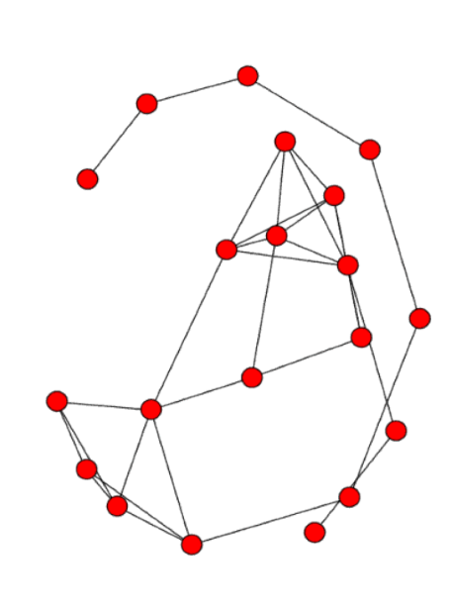
Complex Network Analysis in Economics
By Navya Agarwal

Slide 2
About me
My name is Navya Agarwal
I am a 3rd year CS student at IGDTUW
I am an Outreachy intern at NetworkX
Connect with me on twitter @Navya_Agarwal_

Slide 3

github.com/navyagarwal/complex_network_analysis_in_economics-PyConIn23/

Slide 4
Complex Network Analysis
It refers to the exploration of complex networks.
Complex networks are graphs/networks that exhibit non-trivial topological features.
Their characteristics go beyond those of simpler network structures like lattices or random graphs.
Complex networks mirror real-world systems
Notes:
Complex Network Analysis involves the exploration of complex networks, which are essentially graphs or networks that exhibit non-trivial topological features.
These are characteristics that go beyond what you'd find in simpler network structures like lattices or random graphs.
Complex networks often mirror real-world systems, and the study of these networks is a dynamic and relatively young field of scientific research, emerging around the year 2000.

Slide 5

Why should you care about Complex Networks?
Notes:
This area of study was largely inspired by the observation of complex networks in various domains, including computer networks, biological networks, transportation and social networks. In essence, it's about understanding the intricate patterns and connections that underlie the complexity of the world around us.

Slide 6
Why Network Analysis in Economics?
The behavior of the economy cannot be investigated by individually studying the constituting components of it but only by considering the interplay between all relevant parts
Notes:
In recent years, there has been more and more interest in studying economy related questions by means of network science. A reason for this interest builds on the realization that the behavior of the economy cannot be investigated by individually studying the constituting components of it but only by considering the interplay between all relevant parts. This is in strong contrast to the standard economic theory.
Over the past two decades, research on networks in economics has grown exponentially—from a handful of papers up through the late 1990s to thousands today. This explosive growth is due to a number of factors.
First and foremost, to understand many economic behaviors—from the dynamics of product adoption to financial contagions—it is necessary to account for the patterns of interactions. Failing to include network structure can lead to a deficient understanding of an observed behavior and to poor policy design.
Second, there are increasingly well-understood features of networks (e.g., how densely connected a population is, how segregated it is, among others) that have specific and important implications for economic behaviors. This improved understanding has widened the collection of settings in which networks have been analyzed in conjunction with economic consequences, as it is increasingly clear how to account for network structure and relate it to behavior.
Third, increasingly available data and improvements in computational capabilities are enabling the testing and application of models that could not be analyzed even a few decades ago.
Moreover, data on networks of interactions is often available in conjunction with behaviors—which is essential for understanding the economic implications of network structure, and allows us to test theories and evaluate policies, and measure social learning, diffusion, and peer effects.

Slide 7
Explosive Growth in Research on Networks in Economics
To understand many economic behaviors, it is necessary to account for the patterns of interactions.
Improved understanding of network structure and features that have specific and important implications for economic behaviors.
Increasingly available data and improvements in computational capabilities are enabling the testing and application of models that could not be analyzed a few decades ago.
Notes:
In recent years, there has been more and more interest in studying economy related questions by means of network science. A reason for this interest builds on the realization that the behavior of the economy cannot be investigated by individually studying the constituting components of it but only by considering the interplay between all relevant parts. This is in strong contrast to the standard economic theory.
Over the past two decades, research on networks in economics has grown exponentially—from a handful of papers up through the late 1990s to thousands today. This explosive growth is due to a number of factors.
First and foremost, to understand many economic behaviors—from the dynamics of product adoption to financial contagions—it is necessary to account for the patterns of interactions. Failing to include network structure can lead to a deficient understanding of an observed behavior and to poor policy design.
Second, there are increasingly well-understood features of networks (e.g., how densely connected a population is, how segregated it is, among others) that have specific and important implications for economic behaviors. This improved understanding has widened the collection of settings in which networks have been analyzed in conjunction with economic consequences, as it is increasingly clear how to account for network structure and relate it to behavior.
Third, increasingly available data and improvements in computational capabilities are enabling the testing and application of models that could not be analyzed even a few decades ago.
Moreover, data on networks of interactions is often available in conjunction with behaviors—which is essential for understanding the economic implications of network structure, and allows us to test theories and evaluate policies, and measure social learning, diffusion, and peer effects.

Slide 8
Economic Network Types
Directors (management)
Firms
Products
Business Groups
Banks
Investors
Traders
Cities
Countries
Nodes are the building blocks of a network.
Nodes can represent different entities in different networks.
The meaning of each network is derived from the meaning of the nodes.
Notes:
When speaking about economic networks there is actually not one specific meaning of these networks, but it is a complex family of different networks, each one with its own meaning. This complexity stems from the fact that there are different building block for defining the “nodes” in an economic network. In the following, we list some of the most important node types that have been used for constructing economic networks. That means nodes in economic networks can correspond to:
• Directors (management)
• Firms
• Products
• Business Groups
• Banks
• Investors
• Traders
• Cities
• Countries
It is clear that depending on the meaning of the nodes the meaning of the whole economic network is derived. For this reason, if starting from a question to be studied, e.g., providing insights into the trading of countries or the stability of banks, the nodes need to be selected correspondingly. From a different perspective, the selected meaning of nodes allows to either focus on microeconomic or macroeconomic problems. This implies that the granularity of the economic network, as explained below, can be controlled by this.

Slide 9
Type of Economic Network | Meaning of the Network
Directors Network | Common members of the board of institutions; corporate structure between institutions
Interbank Network | Liability between institutions (bank); interconnectedness of banks
Investment Network | Venture capital or investment in firms and corporations
Ownership Network | Influence on corporate decisions
Financial Network | Dependency between stocks; stock market connectedness
Product Network | Individuals co-purchasing products or countries co-producing products
Trade Network | Exchange of goods and services; trading relations between cities/countries

Slide 10
DEMO
Analyze the World Trade data from a network science perspective.
Use NetworkX for visualizing, analyzing and synthetically representing the trade data.
Notes:
We will understand how to use NetworkX for visualizing, analyzing and synthetically representing the network trade data.
We use the BACI-CEPII dataset that contains data on bilateral trade relations of 200 countries at the product level. Products correspond to the “Harmonized System” nomenclature (6 digit code). Compiled by the French research center CEPII, it addresses the limitations of the original UN ComTrade database, which suffers from numerous missing flows.
The trade network of each commodity is represented as a directed graph comprising countries (vertices) and trade relationships (edges), with the edges starting from the export countries and pointing to the import countries. Each edge consists of two attributes - value of the trade and the quantity of the traded commodity, that can act as weights for the edges.

Slide 11

Python package for working with graphs
Used for creating, manipulating, and analyzing graphs
Provides a wide range of algorithms and visualization tools

Slide 12
Let’s jump into it
Notes:
We will understand how to use NetworkX for visualizing, analyzing and synthetically representing the network trade data.
We use the BACI-CEPII dataset that contains data on bilateral trade relations of 200 countries at the product level. Products correspond to the “Harmonized System” nomenclature (6 digit code). Compiled by the French research center CEPII, it addresses the limitations of the original UN ComTrade database, which suffers from numerous missing flows.
The trade network of each commodity is represented as a directed graph comprising countries (vertices) and trade relationships (edges), with the edges starting from the export countries and pointing to the import countries. Each edge consists of two attributes - value of the trade and the quantity of the traded commodity, that can act as weights for the edges.

Slide 13
Invitation to Contribute
https://github.com/networkx/networkx
Improved documentation
New features
Better tests
Code review
Bug fixes
https://github.com/networkx/nx-guides
Pedagogical notebooks
Real world examples

Slide 14
References
1. https://re.public.polimi.it/retrieve/e0c31c0f-23b0-4599-e053-1705fe0aef77/Network%20Analysis%20of%20World%20Trade%20using%20the%20BACI-CEPII%20dataset_11311-862168_Tajoli.pdf
2. https://wits.worldbank.org/trade/country-byhs6product.aspx?lang=en
3. http://snap.stanford.edu/class/cs224w-2016/projects/cs224w-21-final.pdf
4. https://www.eief.it/files/2010/10/luca-de-benedictis.pdf
5. https://repositorio.cepal.org/bitstream/handle/11362/45060/1/S1901067_en.pdf
6. https://www.ncbi.nlm.nih.gov/pmc/articles/PMC9589650/

